Slide 1


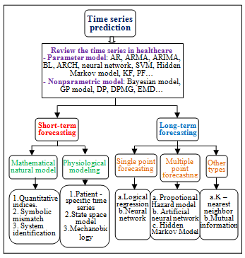
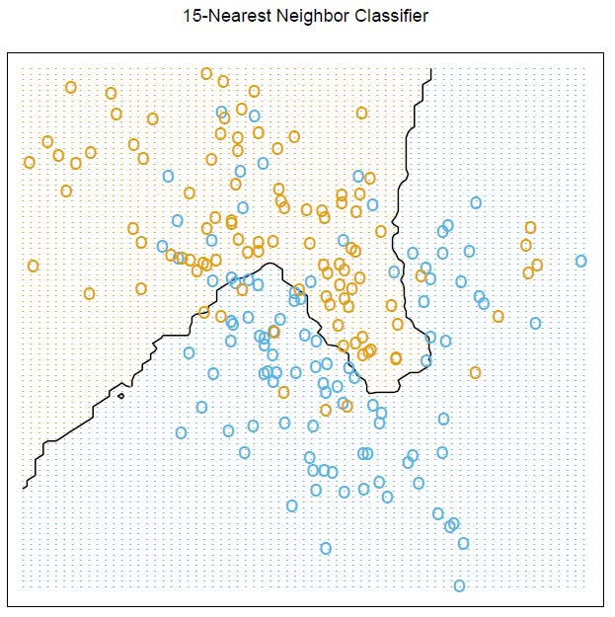
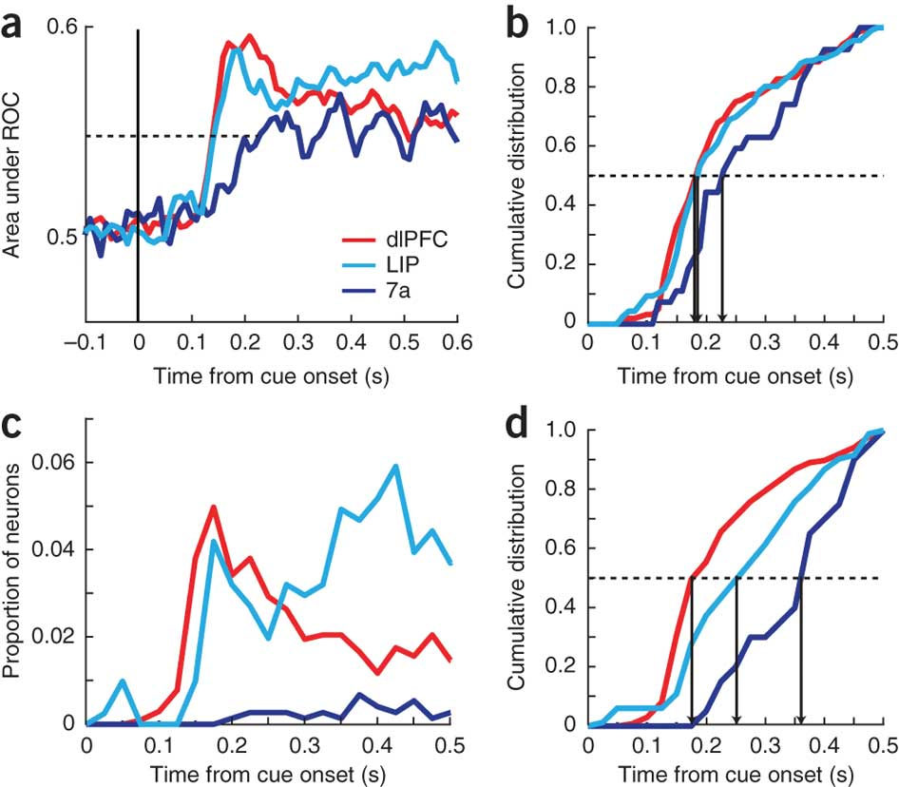
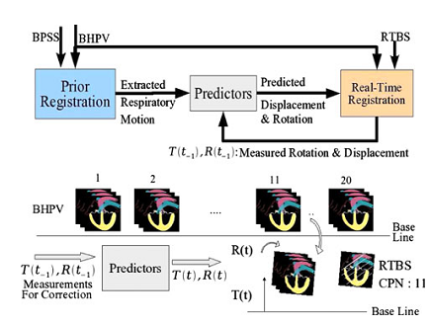
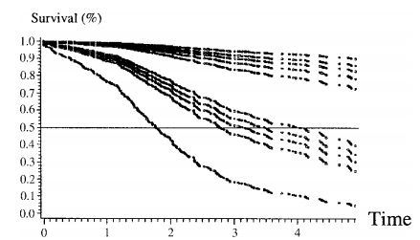

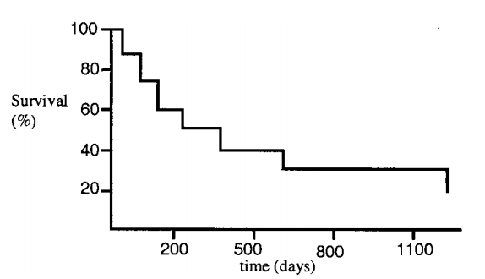
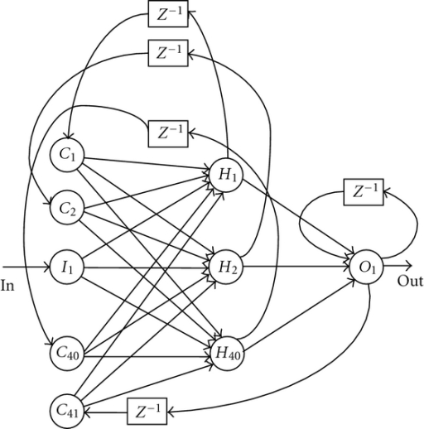
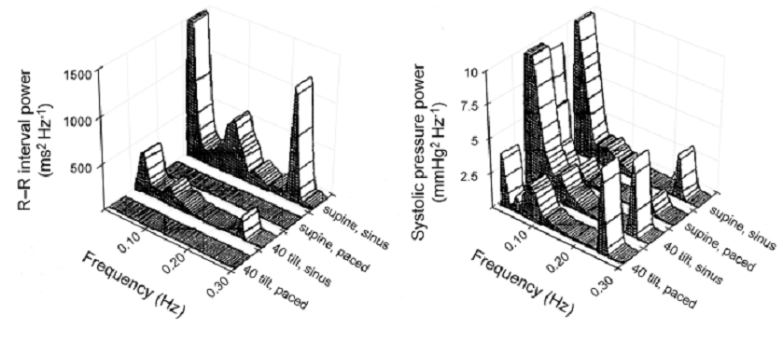

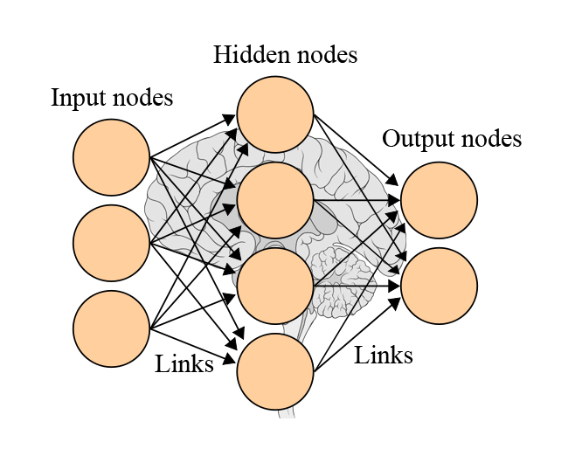
A review on time series forecasting in healthcare informatics with the focus on cardiovascular diseases
Cuc Bui, Nguyen Pham, Anh Tran, An Nguyen, Trung Le
School of Biomedical Engineering, International University, Vietnam National University, HCMC
2. Physiological-based modeling.
The usage of only ECG signal cannot reflect completely the cardiovascular system. It is due to the fact that the body contains organ systems which have effect on each other.
Hence, it is necessary to develop appropriate models to solve this problem
There are three types of approach:
2.1 Patient-specific time series modeling
It is to apply time series models to changes in the physiological system
2.2 State-space Model
It is an N-dimensional time series y_{t} consists of a measurement equation relating the observed data to an m-dimensional state vector α_{t}, and a Markovian transition equation that describes the evolution of the state space over time.
The formulas of this kind of model contain correlation matrices which reflect the association between in-system variables [31].
State-space model includes Markov chain (Random walker), Linear-Gaussian state-space models [32], Kalman filter and their extended versions (e.g. EKF and KS filter) and so on.
2.3 Mechanobiology Modeling
This kind of model has been applied to guide cell culture and test hypotheses related to the role of biomechanical factors in vascular diseases [33].
It has enabled the application of cardiovascular mechanics which is outcome prediction of alternate therapeutic interventions for individual patients.
1.3 Other types of single point forecasting models
k-nearest neighbor approximation (k-NN) and mutual information [31 – 32]
2.1 Proportional Hazard Model
Proportional Hazard Model, one part of the Survival Analysis, is the analysis of data from a time origin to an end time when an event happens, calculating the probability of having that event as a function of time [34 – 35]
2.1 Multiple point Neural Network
III. LONG – TERM FORECASTING MODELS
Benefits of applying long – term forecasting models: avoid tremendous yet unnecessary computational cost that reduce the effectiveness of the model and give overall assessment about the disease condition without relying heavily on capturing the hidden dynamics.
1. Single point forecasting
Single point forecasting models involve calculating the risk of an event or disease condition within a fixed time frame in the future.
The result is usually given in the form a statistical value representing the degree of confidence whether or not the event will occur.
1.1 Logistic Regression
Logistic regression is a parametric model that calculates the probability for an event to happen basing on the data that has been captured in the past known as experience [23].
Involvement: capturing core parameters and develop Logistic Function
Very powerful in predicting mortality after hospital discharge [10]
“Development of a simple risk score for assessing clinical severity of Acute Myocardial Infarction after Hospitalization” [24], strong correlation between mortality and clinical parameters including shock, heart failure, ECG finding, kidney function, and age.
1.2 Artificial Neural Network (ANN)
Artificial Neural Network (ANN) is the general term for a group of Biological Neural Networks models that mimics human cognitive ability to make future predictions basing on the past experience
Figure 4: ANN model
Vast availability, complexity of the underlying dynamics and model accuracy are major challenges in choosing an appropriate forecasting model for research purposes.
Time series forecasting models are mathematical and statistical models that estimate future values based on the past values (experience) with assumptions about the system.
Can be subdivided into 2 categories: Short – term and Long – term forecasting models
Figure 1: Summary the review paper
2. Multiple point forecasting
Multiple point forecasting models construct a mathematical function that predicts the system output with the time as one of the associated variables [10].
Useful to learn about disease progression and compare difference clinical treatments [33].
Figure 5: k-NN and Mutual Information
I. INTRODUCTION
An example about time series predictors were used to speed up real time registration to predict the next position of the heart.
The application of time series prediction in real time cardiac image registration during respiration [14] [29]
Figure 3: RT 2D-3D registration during respiration
using time series predictors
Criteria | Short – term forecasting models | Long – term forecasting models
Characteristics | Makes intensive analysis and calculation to capture disease dynamics | Generally analyses the trend of the available data and effect of the associated parameters
Model outputs | Provide robust and precise predictions up to hours | Provide estimates for years in the future
Applications | Useful in assessing patients’ mortality in emergency care unit where immediate action is crucial Allowing doctors to make immediate response before a vital situation can take place | Thrives at assessing health condition for many years after hospital discharge Allowing doctors to provide suitable healthcare services for these patients
“Predicting Survival In pulmonary arterial hypertension (PAH)” [36] analyzes data from 2716 patients with PAH. The final model can measures patient’s mortality each month after hospital discharge, up to 1 year time span.
Table 2: Short – term and Long – term forecasting
Multiple point Neural Network (NN) [37] is a parametric model that analyzes the past dataset to give prediction of the future event probability. The outputs are given as continuous values in the form of a time series.
In real - life application, Multiple point Neural Network thrives at creating time series prediction for power management [38], pattern classification [28] and signal processing [39]. The same technique can be applied for creating a predictive medical prognostic model [40].
II. SHORT – TERM FORECASTING MODELS
Short-term forecasting techniques can be further divided into 2 types of mathematical-based modeling and physiological-based modeling.
1. Mathematical-based modeling
Mathematical describe the variation of the signal collected from the system over the times by using the mathematical representation and its dynamic variations to estimate the future states.
We categorized into three types of approach:
1.1 The Quantitative Indices
The quantitative indices are constructed to classify broad physiological or pathophysiological conditions.
1.2 Symbolic Mismatch
Symbolic mismatch [20] is based on the principle of comparing long-term time-series with the predefined symbolic sequences.
There are three different methods using symbolic mismatch:
Support vector machine
Nearest neighbor analysis
Hierarchical clustering
1.3 System Identification
Consists of tradition model and its expand model:
Autoregressive-AR [25]
Moving average-MA
Mixed-ARMA
Figure 6: Multiple point neural network
IV. DISCUSSION
Short - term Forecasting models | Long - term forecasting models
Quantity related values | Probability related values
Use correlation to verify the result | Use ROC curve, R Square to verify
Make immediate responses to disease abnormalities | Decision making and learning disease dynamics
Make intensive calculation | Less intensive calculation
These indices are ratios of low to high frequency spectral power have been used to evaluate ‘sympatho-vagal balance’ [15] whereas Mayer wave frequency power has been used to classify congestive heart failure patients [16] or predict death after heart attacks [17] [18]
V. MODELS SUMMARY
Figure 2: R–R interval and systolic pressure power
Type | Application
Parametric model | Predict and classifies disease
ARIMA models. | Parameter identification, Forecasting, Time series modeling
Reviewed AR and ARMA | Signal processing, classification, adaptive control
AR, ARMA, PAR, BL Models | Signal analysis and prediction, arrhythmia classification, signal modeling, and signal classification
Neural Networks | Health informatics, clinical decision-making
SVM-based forecasting methods | Early diagnosis of Alzheimer disease, Breast cancer detection, Prediction of Diabetes
Hidden Markov Models | Applications in genomics, Disease diagnosis and signal analysis
State space model | Signal analysis and processing, Modeling and decoding
PF (Particle Filter) models | Spectral estimation of non-stationary EEG using PF Respiratory rate extraction from pulse oximeter
Bayesian model | Applications in biostatistics, genomics, Analysis of population
GP model (MPG model) | Multi-task Gaussian process models for biomedical applications
Empirical Mode Decomposition (EMD) | ECG signal de-noise and baseline wander correction, Heart rate variability analysis
by applying a predefined Training Function [25 – 27].
Suitable for complex system with large amount of parameters input and data records, but need strong computational system and storage.
“Prediction of protein stability changes upon single-point mutations” [30], A dataset of 1615 mutations are documented with numerous input parameters and the model predicts 90% in accuracy
Autoregressive integrated moving average-ARIMA [23]
Autoregressive conditional heteroskedastic-ARCH
Generalized autoregressive conditional heteroskedastic-GARCH
For references please visit: https://drive.google.com/drive/folders/0Bwc9U3g6cQ32UzRZcTFvT3RWRk0

